Slide 1
Random Module In Python

Slide 2
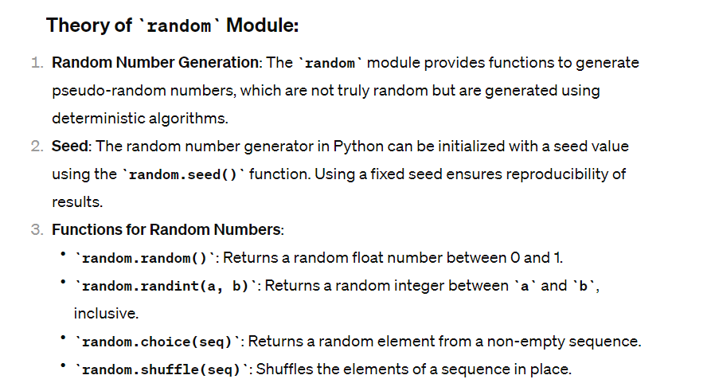
The random module in Python provides functions for generating random numbers and choosing random elements from sequences. It's a versatile module that's commonly used for simulations, games, statistical sampling, and cryptography.

Slide 3
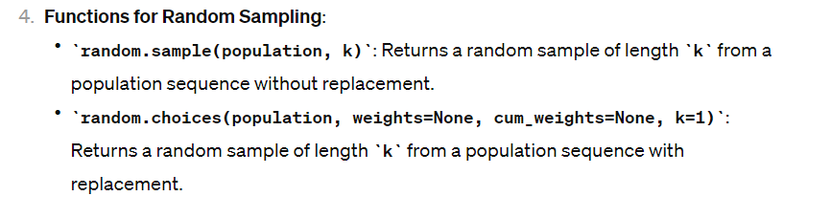

Slide 4
1. Generating Random Numbers:
2. Choosing Random Elements:
import random
# Generate a random float number between 0 and 1
random_float = random.random()
print("Random float number:", random_float)
# Generate a random integer between 1 and 100
random_int = random.randint(1, 100)
print("Random integer:", random_int)
import random
# Choose a random element from a list
my_list = ['apple', 'banana', 'cherry', 'date']
random_element = random.choice(my_list)
print("Random element:", random_element)

Slide 5
3. Shuffling Elements:
4. Random Sampling:
import random
# Sample 3 elements without replacement from a list
my_list = ['apple', 'banana', 'cherry', 'date']
sample = random.sample(my_list, 3)
print("Random sample without replacement:", sample)
# Sample 5 elements with replacement from a list with weights
weights = [0.1, 0.2, 0.3, 0.4]
sample_with_weights = random.choices(my_list, weights=weights, k=5)
print("Random sample with replacement and weights:", sample_with_weights)
import random
# Shuffle a list in place
my_list = [1, 2, 3, 4, 5]
random.shuffle(my_list)
print("Shuffled list:", my_list)

